Slide 1
Introduction to Machine Learning and Deep Leaning

Slide 2
Before Machine Learning

Slide 3
Models, models, models “experimental data”
We build models all the time. What are the models ?
Why models are important ?
What do models give us as scientists and engineers ?

Slide 4






Need to select the capacity of the circuit breaker.

Slide 5
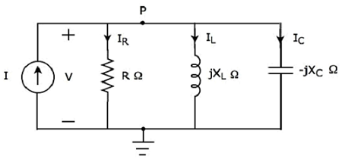
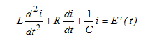
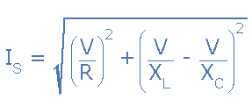
The classical approach
Step 2: Build the electric model.
Step 3: find The mathematical model and use it.

Slide 6
But Sometimes Modelling with fundamental laws is really hard. Because: 1 - Maybe we don’t have enough “Science”. 2- The phenomena under study is really complicated, and very stochastic in nature. “ consider economic, social, biological, and climate phenomena”.

Slide 7
What is Machine Learning ?
Traditional programming vs Machine learning.

Slide 8
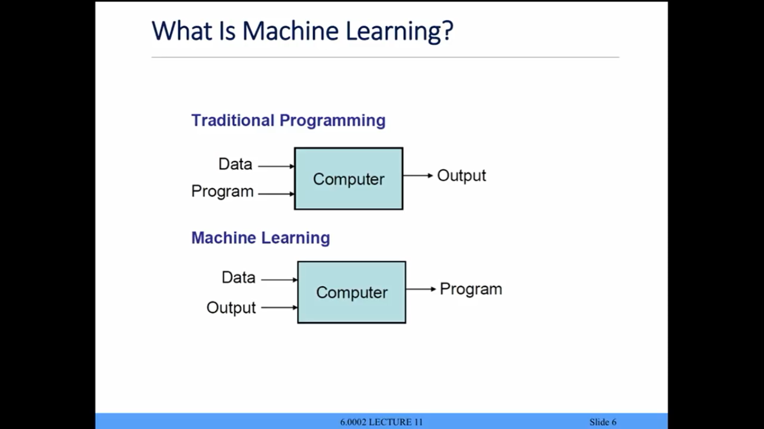
How would ML solve the previous problem ?
Traditional programming vs Machine learning.

Slide 9
The main steps of Machine Learning
Problem definition.
Model selection.
Feature extraction.
Optimization.
Using the model.

Slide 10
Optimization
Features
Model
Output
Loss

Slide 11
What are the features? Why are they important ?
Back to modelling ? How do we get features ?

Slide 12
Underfitting Vs Overfitting
BBBBut why overfitting is bad ? It doesn’t make sense.
The sweetspot.

Slide 13
Deep Learning
Optimization
Features
Model
Output
Loss

Slide 14
Pigeon superstition

Slide 15
Case study: Snake Classification

Slide 16
The most Important take away
All models are WRONG but some are USEFUL.
Garbage in Garbage out !

